Slide 1
Introduction to HPC and SLURM
26 June 2020, 9:30 am – 3:00 pm
MONASH DATA FLUENCY
Instructors : Simon Michnowicz
Damien Leong
Helpers: Nick Wong
Tyrone Chen
Ranjeet Singh
Luhan Cheng
Jay Van Schyndel
Notes:
----- Meeting Notes (3/06/13 14:11) -----

Slide 2
Course Objectives
Understand basic parallel computing concepts and workflows
Understand the high-level architecture of a supercomputer
Introductory Unix
Use a basic workflow to submit a job and monitor it
Understand a resource request and know what to expect

Slide 3
If you need to leave early, don’t forget you MUST fill out a feedback form to get credit for this course. We will remind you at the end.
https://forms.gle/ALT2SRLpmJjMSJCaA

Slide 4
Course Materials
SLACK CHANNEL:
https://datafluency.slack.com/archives/C015HBQ6WAH
Link to Slides:
https://docs.google.com/presentation/d/19OsFBNn3wsQspFxK-y1i6BKFQwUK6y_4YsstsnOMs6w/edit?usp=sharing
Something else to read:
https://gintan.github.io/intro-to-hpc/

Slide 5
CHAPTER 1: WHY USE A CLUSTER?

Slide 6
Major Domains where you find HPC
Weather Research | Computational Mathematics | Banking and Finance | Chip design and Semiconductor | Life Sciences | Seismic Analysis | Scientific Analysis
Atmospheric modelling | Monte-Carlo methods | High throughput trading | Transistor simulation | Genomic sequencing | Reservoir Simulation and modelling | Molecular modelling
Seasonal time-scale research | Parallel time algorithms | Financial analysis modelling | Electromagnetic field solver | Protein folding Drug Design | Seismic data processing | Computational Chemistry

Slide 7






HPC CLUSTERS
Slurm-login
Pawsey
(Perth)
NCI
(Canberra)
#25
Fugaku
(Japan)
#1
slurm0
slurm1
slurm2
Our cluster for today!
And getting bigger all the time. See https://www.top500.org/

Slide 8
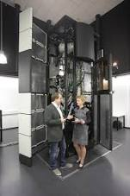
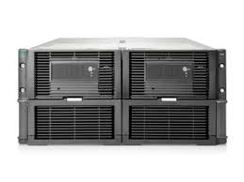


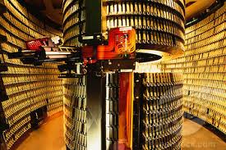
e-Research Workflows
Collect
Massive amounts of data are generated by modern instruments
Stage
Data has to be stored
Process
Single Large Job?
Large parallel jobs?
Multiple small jobs?
Visualise
Examine values, generating images, interact
Archive
Long term storage, sharing

Slide 9
You need a cluster when your research needs..
Speed
more CPU cores, often with higher performance specs, i.e. memory, disk speed, network speeds
Volume
Terabyte and Petabyte disk storage ( Spinning Disk, Solid State Disk, tape)
Efficiency
Many HPC systems operate a pool of resources, running most of the time
Cost
Often free to researchers due to competitive grants (i.e. NCMAS).
Convenience
Professionally managed with advanced user support

Slide 10
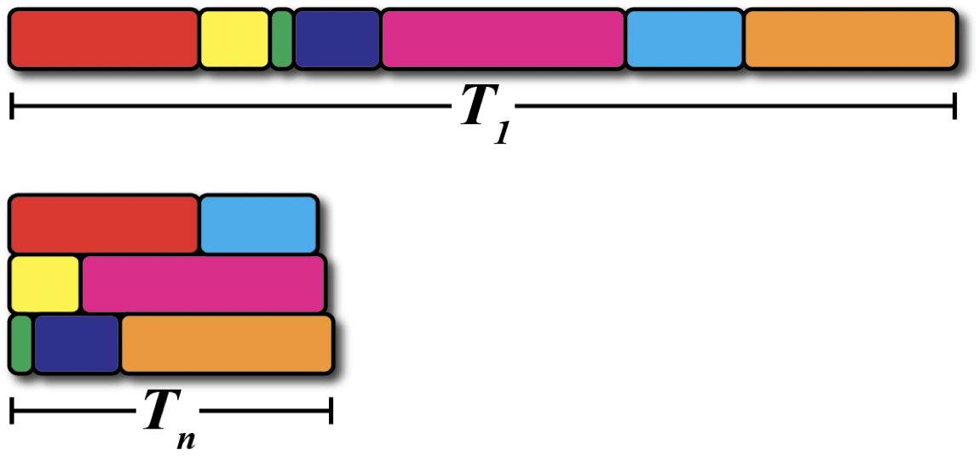
Parallelism in Workflows
Exploiting parallelism in a workflow allows us to
get results faster, and
break up big problems into manageable sizes.
A modern supercomputer is not a fast processor. It is many processors working together in parallel

Slide 11
Workflow Example – Cake Baking
It has a sequence of tasks that follow a recipe. Just like a computer program!
Some tasks are independent
Can be done in any order.
Can be done in parallel.
Some tasks have prerequisites.
Must be done sequentially.

Slide 12
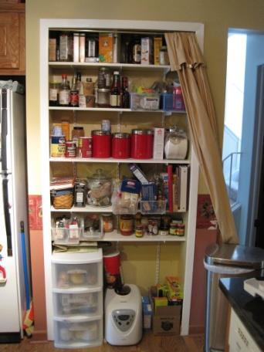
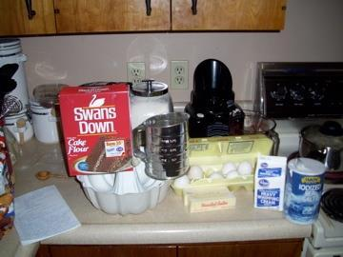

Baking a Cake - Staging
Staging” the ingredients improves access time.
Ingredients are “prerequisites”.
Each ingredient does not depend on others, so can be moved in parallel, or at different times.
Supermarket
Pantry
Bench

Slide 13

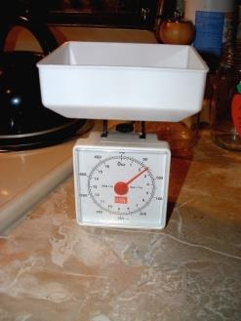
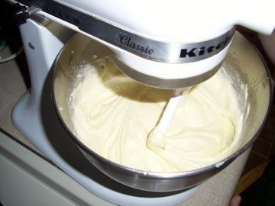
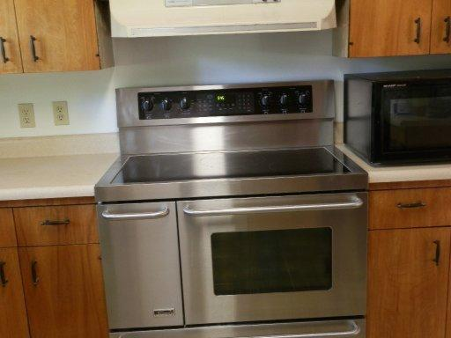

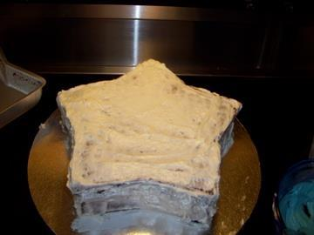
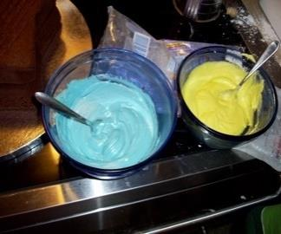
Baking a Cake - Process
Stage Ingredients
Measure Ingredients
Mix Ingredients
Preheat Oven
Serial
Bake and
cool cake
Parallel
Mix icing

Slide 14
Levels of Parallelism
Coarse-grained parallelism (high level)
Different people baking cakes in their own kitchens.
Preheating oven while mixing ingredients.
Greater autonomy, can scale to large problems and many helpers.
Fine-grained parallelism (low level)
Spooning mixture into cupcake tray.
Measuring ingredients.
Higher coordination requirement. Difficult to get many people to help on a single cupcake tray

Slide 15
How many helpers?
What is your goal?
– high throughput, to do one job fast, or solve a grand-challenge problem?
High Throughput:
For many cakes, get many people to bake independently in their own kitchens – minimal coordination.
Turn it into a production line. Use specialists and teams in some parts.
Doing one job fast:
Experience as well as trial and error will find the optimal number of helpers.

Slide 16
A simple example
Add 1 to each element of an array of size 1000. We have previously put values 0..999 into the array
System
Memory
CPU with 4 compute cores
0
1
2
Memory Bus
...
997
998
999

Slide 17
Serial example
We have to process each element one at a time
System
Memory
CPU with 4 compute cores
0
0
+1
Move first value to cpu
Increment value
Write result back to memory
1
1
2
0
...
997
998
999

Slide 18
Serial example
Afterwards...Then repeat for the 999 other values
System
Memory
CPU with 4 compute cores
1
+1
1
1
2
2
1
...
997
998
999

Slide 19
Parallel example
Start using all the available cores
System
Memory
CPU with 4 compute cores
0
0,1,2,3
+1
+1
Move 4 values to cpu
Increment values
Write results back to memory
1
2
1,2,3,4
0
1
3
+1
+1
...
2
3
997
998
999

Slide 20
Parallel example
We should be getting a ~4x speed improvement..
System
Memory
CPU with 4 compute cores
1
Move values to cpu
Increment values
Write results back to memory
2
3
Processing
Next 4 values
4
...
997
998
999

Slide 21


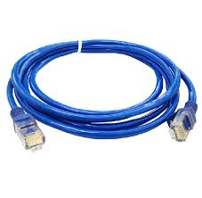
Parallel example -with multiple computers
If we have multiple computers, can we get them to help as well?
Yes, but we have to send data via a message (over a communications channel)
DATA

Slide 22

Parallel example - multiple servers
Send some of the data to another computer for processing
Computer 1
Computer 2
System
Memory
CPU with 4 compute cores
System
Memory
CPU with 4 compute cores
0
0,1,2,3
+1
+1
4
4,5,6,7
+1
+1
1
5
2
1,2,3,4
0
1
6
5,6,7,8
4
5
...
3
+1
+1
7
+1
+1
2
3
6
7
997
998
999
Send data to remote computer via network: - 4,5,6,7

Slide 23
Parallel example - multiple servers
The results have to be sent back. The arrival will not be synched with whatever Computer1 might be doing at the time.
System
Memory
Computer 1
Computer 2
CPU with 4 compute cores
System
Memory
CPU with 4 compute cores
1
2
5
3
6
4
7
8
...
997
998
999
Send results back:- 5,6,7,8

Slide 24


Message passing lets us scale up the number of computers we can use
But the time to send data and receive results can make a big difference to our program performance. There are many questions to ask:
How much data do we send in a message?
In our example, if we had 10 computers it might make sense to send 100 values
But if your program is using all the memory in the computer, then there may not be enough space for buffers to store the message
There has to be a way for the program to synchronise all the results coming back.
Message passing libraries such as Message Passing Interface (MPI) will do these tasks for you
A slow link or a poor parallel algorithm can make the computers wait for data to process. This can be measured with diagnostic tools..

Slide 25
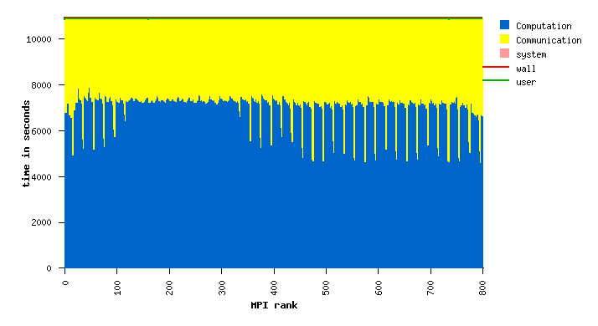
A good parallel program.
Lots of time spend in computation
Not that much time spend in communication

Slide 26
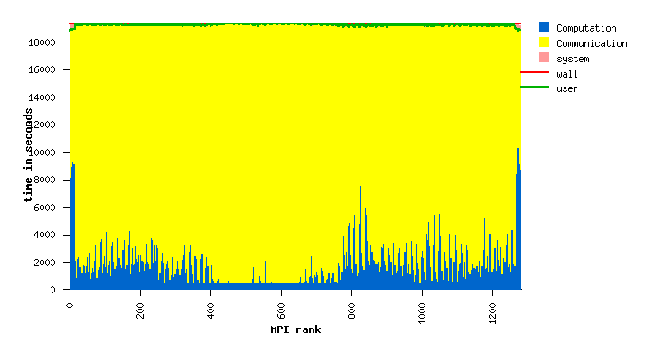
A poor parallel program.
Not much time spent in computation
Too much time spent in communication

Slide 27
When to use supercomputing
Workflows need supercomputing when the resources of a single laptop or workstation are not sufficient:
Workflows need supercomputing when the resources of a single laptop or workstation are not sufficient when:
The program takes too long to process
There is not sufficient memory for the program
The dataset is too large to fit on the computer
If you are unsure whether moving to a supercomputer will help please email:
mcc-help@monash.edu

Slide 28
What to expect in a HPC System
Login Node(s)
Users login into a computer and use it to prepare data and processing jobs
e.g. slurm-login for today’s course
Data Transfer Node(s)
Users use this to transfer large data files (so as to not interfere with those on the Login Node)
We do not have a DTN on our cluster
Data Storage
Most have a large parallel file system (e.g.CEPH, Lustre), often with tape archive.
We have CEPH Storage Volume on /mnt/nfs
Batch Scheduler
To ensure a fair usage of compute resources, a scheduler will run your jobs
SLURM
Software
HPC systems have pre-installed software to use. Don’t reinvent the wheel!
Environment modules
Data
Often large domain-specific data sets are stored on HPC systems
e.g. bioinformatics databases

Slide 29
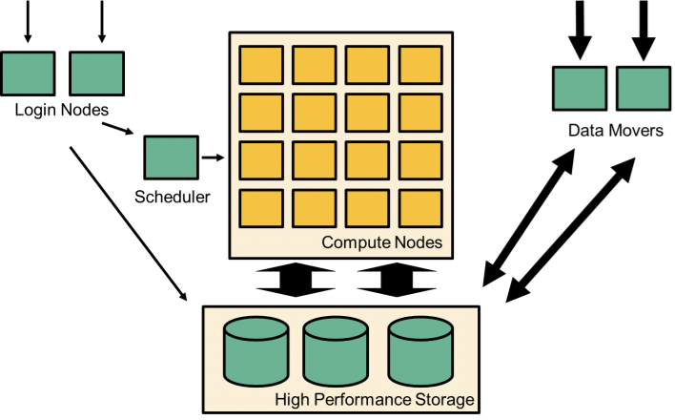
Login Nodes
Remote access to the supercomputer
Where users should manage workflows
Many people (~100) can share a login node at the same time.
Do not run your programs on the login nodes!
Use the login nodes to submit jobs to the queue to be executed on the compute nodes
Login nodes can have different hardware to compute nodes.
• Some build tests may fail if you try to compile on login nodes.

Slide 30
Compute Nodes
Programs should run on the compute nodes
Access is provided via the scheduler
Compute nodes have a fast interconnect that allows them to communicate with each other
Jobs can span multiple compute nodes
Individual nodes are not that different in performance from a workstation
Parallelism across compute nodes is how significant performance improvements are achieved.
Nodes typically have access to the shared ‘global’ filesystem

Slide 31
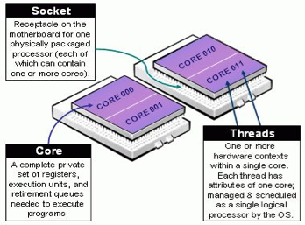
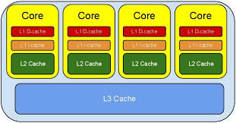
Inside a Compute Node
Each compute node has one or more CPUs:
Each CPU has multiple cores
Each CPU has memory attached to it
Each node has an external network connection
Some systems have accelerators (e.g. GPUs)

Slide 32
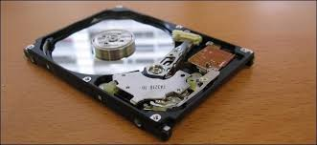
File Systems
HPC systems typically have many filesystems
Each file systems typically has very different properties
Users will have quotas on their file systems
Amount of data they can have (~GB)
The number of files they can have (inodes)
Some file systems are:
Local only to the compute node (e.g. /tmp)
Global across all nodes (e.g. /mnt/home)
Some file systems are backed up to tape, some not
Some are high-performance parallel file systems, others not
Please consult the documentation when using a HPC system

Slide 33


Schedulers
All HPC systems have a queuing system that examines your job requirements and finds available hardware, where it is placed in a queue until it is scheduled to run on a compute node.
More will be covered later, but behind the scenes, schedulers are often considered to be like a game of Tetris...

Slide 34
Cloud vs HPC
CLOUD
Uses Virtual Machines
Expect >10% performance hit on disk and network operations
Users buy remote compute resources
Users control the creation, use and destruction of remote machines
They must be sys-admins on the machines
They only use what they need, when they need it
Exclusive access to the servers
Users need to transfer data to the remote servers, and download the results
Privacy and security issues are important
HPC
Large remote clusters of computers
Computer architecture is static
Users access servers via schedulers
You may have to wait for your jobs to run
Machines optimized for speed and performance
Machines may not be the fastest processors available, with the emphasis on the number of processors and fast interconnect
Help Desks
Pre-installed software packages
Usually fast network interconnect
Infiniband, ROCE
Access via grants

Slide 35
HPC On Cloud
HPC services can also be delivered on a Cloud Infrastructure
MonARCH and M3 both are built on the Nectar Openstack Cloud
These compute servers use Mellanox Network cards, which allow VMs to access the network hardware directly, without having to go through the Host Operating System
A fully tuned VM can meet ~98% performance of a bare metal machine, averaged over a number of benchmarks
Pros:
Ease of use in creating, deleting nodes
Cons:
More complex cloud setup
Harder to find bugs
Still a small performance degradation

Slide 36


CHAPTER 2: Connecting to the cluster

Slide 37
Secure Shell (ssh)
Logging into servers requires a ssh client on your local computer
Common terminal programs:
Windows
use putty (download https://www.putty.org/)
Or MobaXterm (download https://mobaxterm.mobatek.net/)
Or Cygwin if you are an advanced user
Linux, use Terminal (preinstalled)
OS X, use Terminal (preinstalled) or iTerm2 (download)

Slide 38



Secure Shell (ssh)
Logging into servers requires a ssh client on your local computer
OS | TOOL | Command
Mac | ssh is already in your terminal window | ssh username@118.138.242.181
Unix/Linux | ssh is already in your terminal window | ssh username@118.138.242.181
Windows | If you have a Cygwin terminal | ssh username@118.138.242.181

Slide 39
Example. ssh simon@118.138.242.181
The authenticity of host 'localhost (127.0.0.1)' can't be established.
ECDSA key fingerprint is SHA256:CCVXbbNqjWEv9bvtcnzNT3O2n3ii9Y5rhg0GvqOXXiM.
ECDSA key fingerprint is MD5:4b:84:40:45:bd:05:27:cf:c3:33:99:58:96:13:d2:d0.
Are you sure you want to continue connecting (yes/no)? yes
Warning: Permanently added 'localhost' (ECDSA) to the list of known hosts.
Password:
Last login: Wed Aug 1 05:43:30 2018
--------------------------------------------------------------------------------
Nectar CentOS 7 (Core)
Image details and information is available at
https://support.ehelp.edu.au/support/solutions/articles/6000106269-image-catalog
--------------------------------------------------------------------------------
[simon@slurm-login ~]$
The very first time you log in, you will get a ssh-key exchange message, and you will be asked to accept the key. Hit. ‘Yes’. This won’t happen again.
You are prompted for password. Your will not see the password when you type. This is a security measure

Slide 40
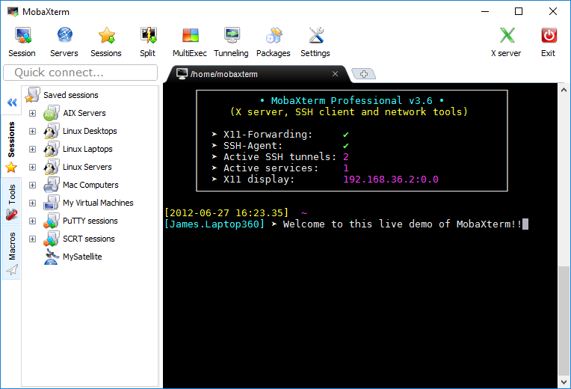
Using MobaXterm (Windows Only)
MobaXterm is a Windows GUI often found on computers. Besides a ssh terminal, it has a X-client so you can run graphics programs on the Unix Server
If you are on a windows box, and do not have MobaXterm, please download it now if you want to use it.
https://mobaxterm.mobatek.net/

Slide 41
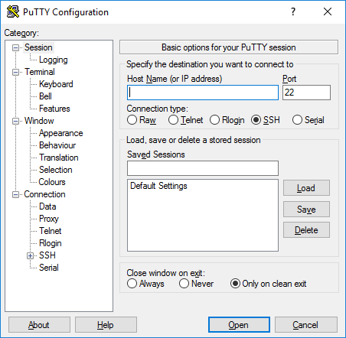
Using PUTTY (Windows Only)
PUTTY is a Windows GUI often found on computers.
If you are on a windows box, and do not have putty, please download it now if you want to use it.
http://www.putty.org/
Advanced Users:
If you want a Unix experience on windows,
then install Cywgin
https://www.cygwin.com/
(We will use putty today is it is a lot easier to install and configure)

Slide 42
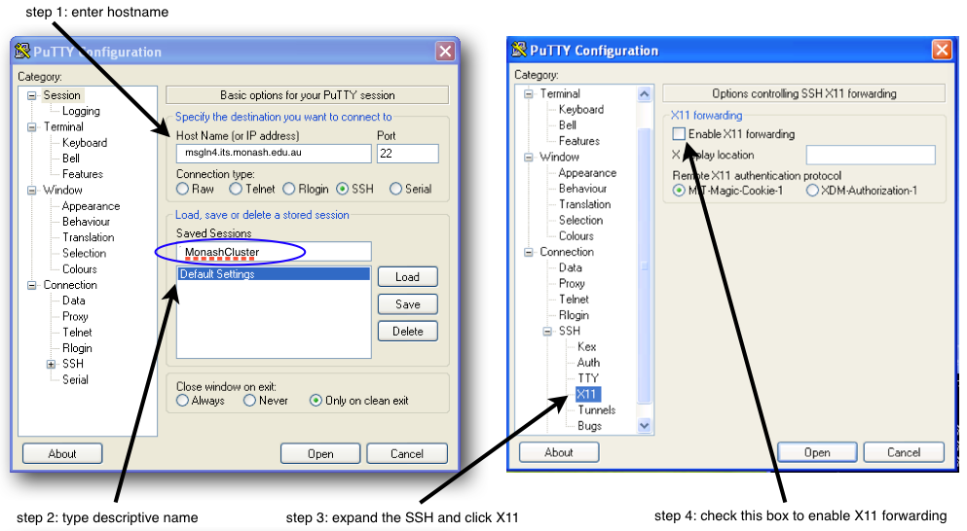
Using PUTTY (Windows Only)
PUTTY is a Windows GUI often found on computers. For the course set ‘Host Name’ to 118.138.242.181

Slide 43
Account Security
SSH uses fingerprints to identify computers ... so you don't give your password to someone pretending to be the remote host
Do not share your account with others, this violates the conditions of use (have the project leader add them to the project)
Please do not provide your password in help desk tickets, nobody ever asks for your password via email as it is not secure

Slide 44
For all exercises use the sticky notes.
For all exercises:
Enter a breakout room (there is 1 tutor per room
Leave the room when you are finished
Need help
All Good

Slide 45
First Challenge
Open the course material in a web page
Login to our slurm login node 118.138.242.181
You will needs the username and password provided to you
Then let us know when you are finished…
Need help
All Good

Slide 46

Chapter 3:Scripts, variables

Slide 47
Unix Scripts
Shell commands can be placed in text files and executed. e.g. file.sh
-the files should have execute permission on them,
i.e. chmod +x file.sh
-the files are plain text files (and are not compiled)
The first line of the file is used to specify the shell being used.
#!/path/to/shell
e.g.
#!/usr/bin/bash
Or
#!/bin/bash
This will be machine dependent –where did they put the bash executable?
‘#’ normally indicates a comment line.
Then put whatever commands you want to execute.
Then you can run the command as if it were an executable.
./file.sh
OR run it with the correct shell command
sh file.sh

Slide 48
Unix Scripts
mycommands.sh
$ nano mycommands.sh
$ chmod +x mycommands.sh
$ ./mycommands.sh
What do you expect to see?
#!/bin/bash
ls

Slide 49
Editors - revision.
UNIX has several in-built editors to create text files.
vi/vim - screen oriented text editor. As old as Unix..
emacs – also created decades ago. Part of GNU project.
nano – simple micro editor
Plus many more….
Nano is the easiest editor to use in a beginner’s course…
nano myfile.txt
vi myfile.txt
emacs myfile.txt
Either command creates a new file ‘newfile.txt’ if it does not exist, or edits an existing file.

Slide 50
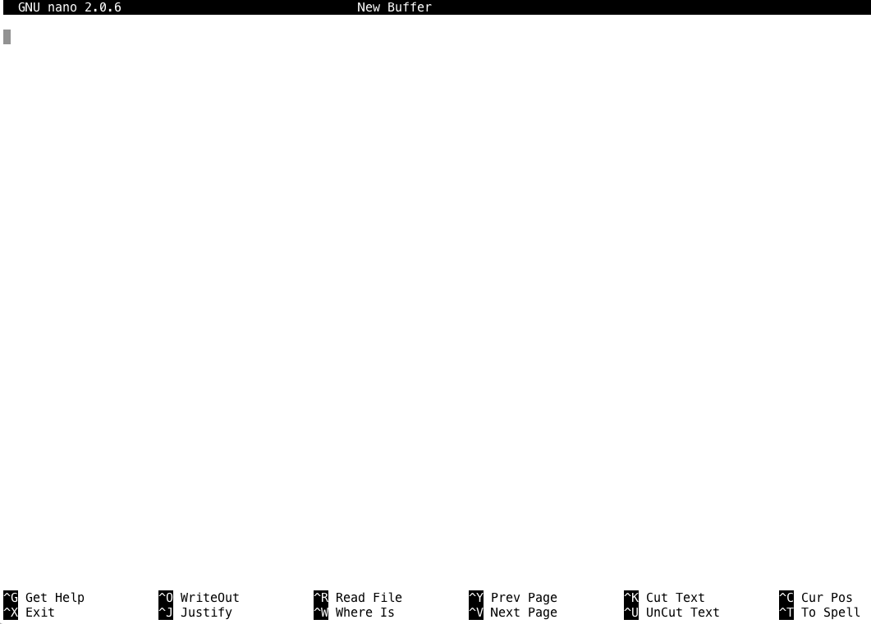
NANO

Slide 51
Shell Variables
X=1

Slide 52
VARIABLES
Shells are programs like any other, and like all programs, they have variables that control their behaviour. You can view the shell variables you have by typing
env
or
printenv
BASH=/bin/bash
BASH_ARGC=()
BASH_ARGV=()
BASH_LINENO=()
BASH_SOURCE=()
BASH_VERSINFO=([0]="3" [1]="2" [2]="25" [3]="1" [4]="release" [5]="x86_64-redhat-linux-gnu")
BASH_VERSION='3.2.25(1)-release'
COLORS=/etc/DIR_COLORS
COLUMNS=172
CONDOR_CONFIG=/opt/vdt/condor/etc/condor_config
CVS_RSH=ssh
…
…
etc

Slide 53
COLUMNS=172
Convention makes variable names upper case
Variable values are always strings, and have to be converted to other types if necessary.
MANPATH=:/usr/share/man:/opt/n1ge62/man
When variables contains lists of values, the convention uses the : character as the delimiter

Slide 54
The PATH variable controls where the shell looks for executables.
PATH=/usr/lib64/qt-3.3/bin:/usr/kerberos/bin:/usr/local/bin:/bin:/usr/bin:/opt/n1ge62/bin/lx24-amd64:/opt/dell/srvadmin/bin:/nfs/home/hpcmerc/vlad/bin:/usr/bin:/usr/ucb:/etc:/opt/vdt/condor/bin:/opt/vdt/jdk1.5/bin:.
./myprog.exe
/bin/myprog.exe
myprog.exe
This runs myprog.exe in the current directory
This runs myprog.exe found in /bin
Which program is executed here?
The shell separates the paths found in the PATH variable and searches each one in order for the program to execute.

Slide 55
/usr/lib64/qt-3.3/bin
/usr/kerberos/bin
/usr/local/bin:/bin
/usr/bin
/opt/n1ge62/bin/lx24-amd64
/opt/dell/srvadmin/bin
/nfs/home/hpcmerc/vlad/bin
/usr/bin
/usr/ucb
/etc
/opt/vdt/condor/bin
/opt/vdt/jdk1.5/bin
.
Order of search
Current directory ‘.’ last to be searched, but only because of its position in PATH. Some systems do not put ‘.’ In the PATH at all. Can you think why?

Slide 56
Printing Variables
The ‘echo’ command can be used to print variables. A $ is needed to discriminate between text and variables.
echo HOME
HOME
echo $HOME
/nfs/home/hpcmerc/vlad
You can create a variable by assigning to it
PIN=1234
echo $PIN
1234
PIN=4321
echo $PIN
4321

Slide 57
To assign a variable in a shell so that it is copied into child processes that it creates, you use the export command.
PIN=1234
export PIN
bash
echo $PIN
1234

Slide 58

(10 min) Exercise.
Write a script file that executes the following commands
date
Date is a unix shell command that prints the time and date
echo 'This script is running on:'
to print the text
hostname
Hostname is a unix shell command that prints the name of the computer you are on
sleep 10
sleep N sleeps for N seconds
echo 'Completed by' $USER
to print the text follow by an environment variable for username
Execute your script from the shell command line and examine the output
Need help
All Good
At the end of this exercise, you should be able to put several shell commands into a file and run them

Slide 59
CHAPTER 4 : Working on a cluster

Slide 60
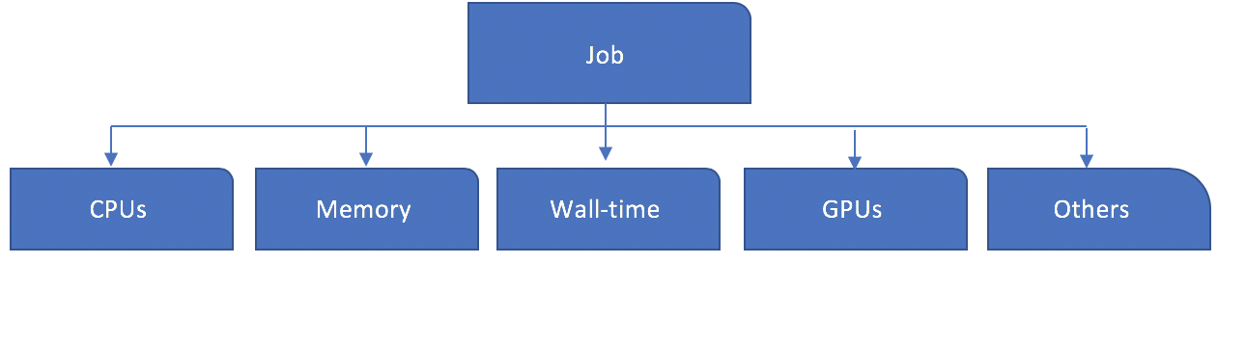
Components of a job
What is inside of a job ?

Slide 61
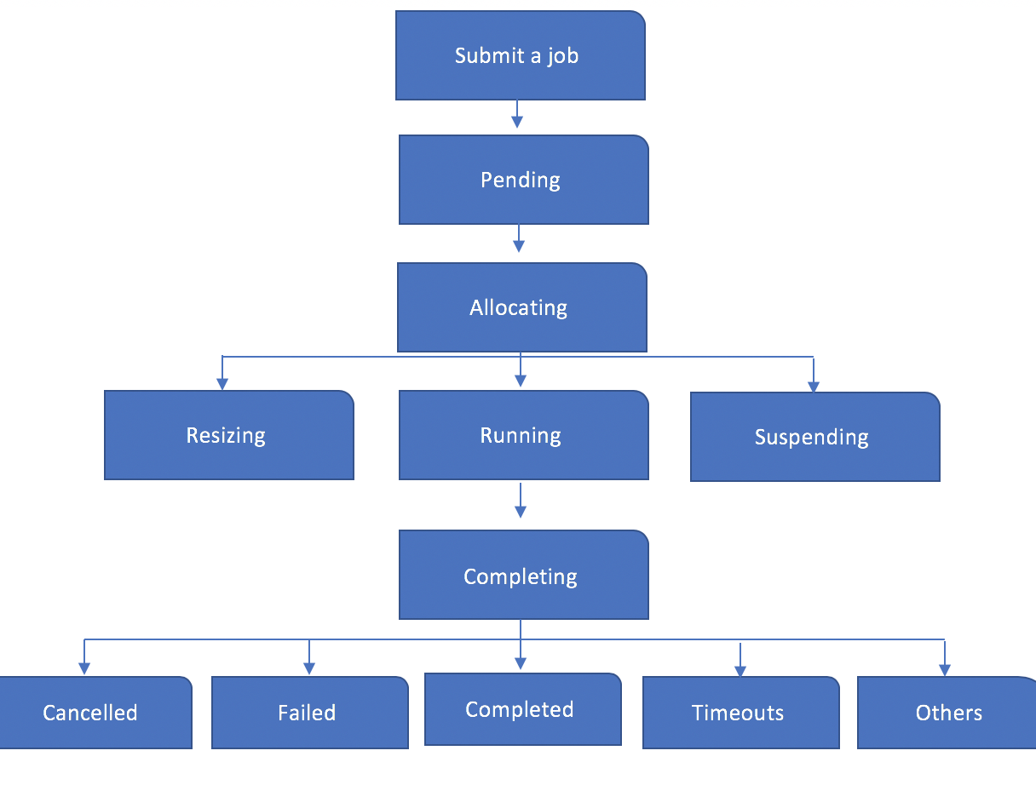
Life cycle of a job

Slide 62
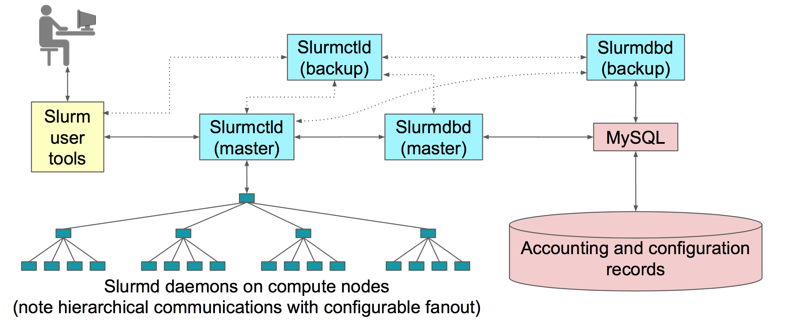
SLURM as a job scheduler and resource manager.
slurm1
slurm2
slurm3
slurmnn

Slide 63
SLURM user commands:
sbatch
Submit a batch script to Slurm
salloc
Obtain a Slurm job allocation (a set of nodes), execute a command, and then release the allocation when the command is finished
srun
run parallel jobs

Slide 64
Exercise (5 min):
Now that you’ve learned how to create a script, we will submit the script to the job scheduler.
Content of firstjob.sh:
#!/bin/bash
date
echo 'This script is running on:'
hostname
sleep 120
echo 'Completed by' $USER
To submit:
sbatch firstjob.sh
Do you get a job ID?
The job ID is for record purposes and it’s very useful when you are troubleshooting your job.
Need help
All Good

Slide 65
While you are waiting for your job to run, investigate what our cluster looks like. You should be able to login into our nodes and investigate them. (Or you can ask SLURM to advise you of some info with scontrol show node <nodename> )
Slurm-login
Node | No of cpus (lscpu) | Total Amount of memory (free -m) | Main disks systems (df -k)
slurm-login
slurm0
slurm1
slurm2
slurm0
slurm1
slurm2
Our cluster for today!

Slide 66
Did you find?
Node | No of cpus (lscpu) | Total Amount of memory (free -m) | Main disks systems
slurm-login | 1 | 1839 | /mnt/nfs
slurm0 | 2 | 1839 | /mnt/nfs
slurm1 | 1 | 1839 | /mnt/nfs
slurm2 | 1 | 1839 | /mnt/nfs

Slide 67
Useful commands to check your job on the scheduler:
scontrol show job {jobID}
When you obtain your job ID, you can check the information about your job
squeue
view information about jobs located in the Slurm scheduling queue
squeue -u {username}
view information about jobs located in the queue for one or more users
scancel {jobID}
Used to cancel jobs or job steps that are under the control of Slurm

Slide 68
squeue -u {username}
squeue

Slide 69
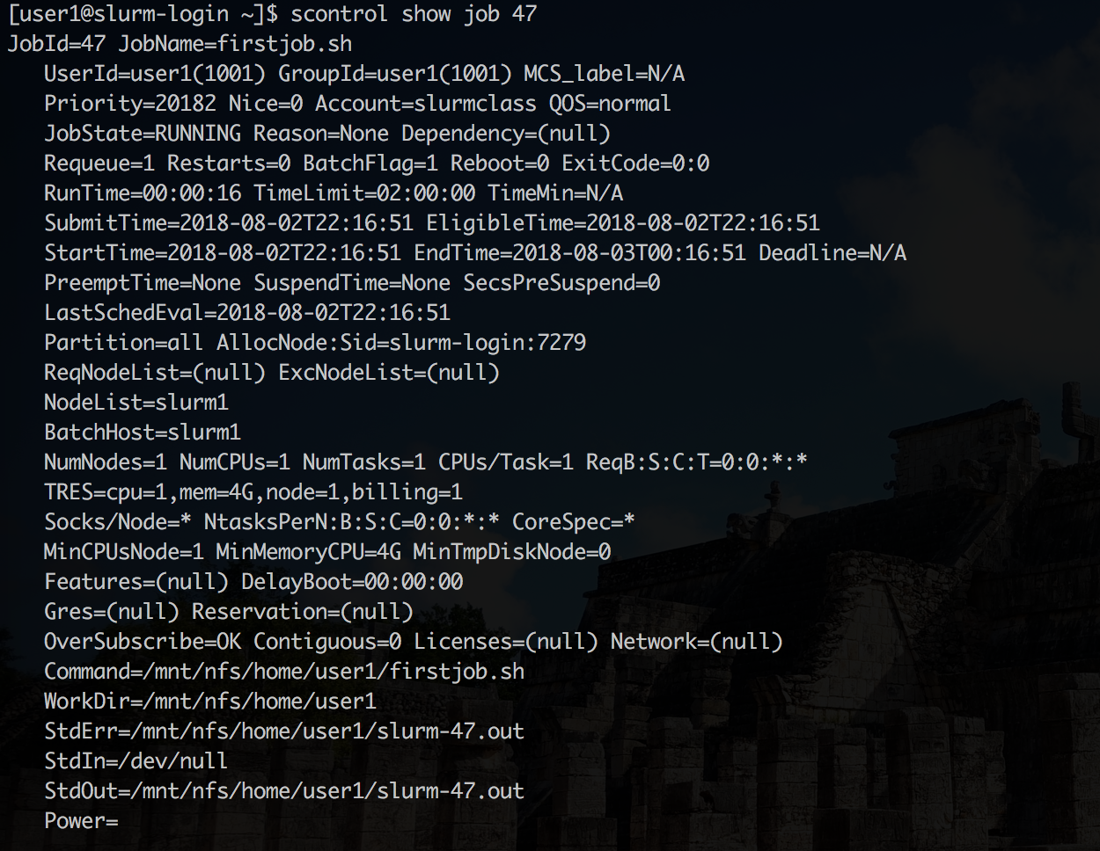

Slide 70
More useful commands to check the information about a compute node:
sinfo
To see all the partition in the queue
sinfo -p {partition name}
if you just want to look at a specific partition, you can parse in -p follow by the name of the partition
sinfo -Nl
to see all the nodes in the job scheduler
scontrol show node {node name}
to see a specific node in the queue

Slide 71
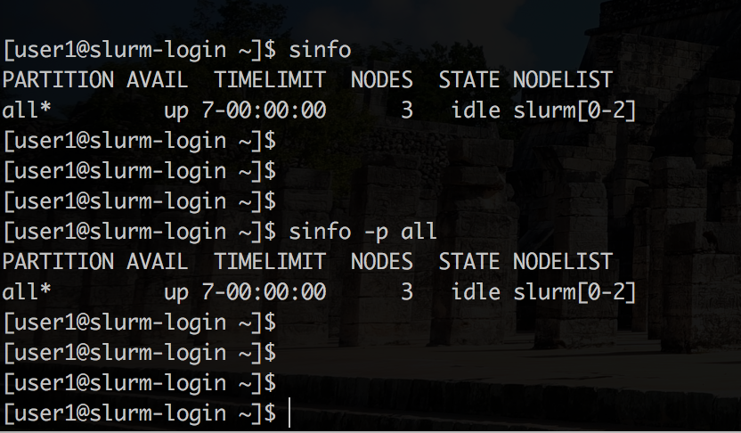

Slide 72
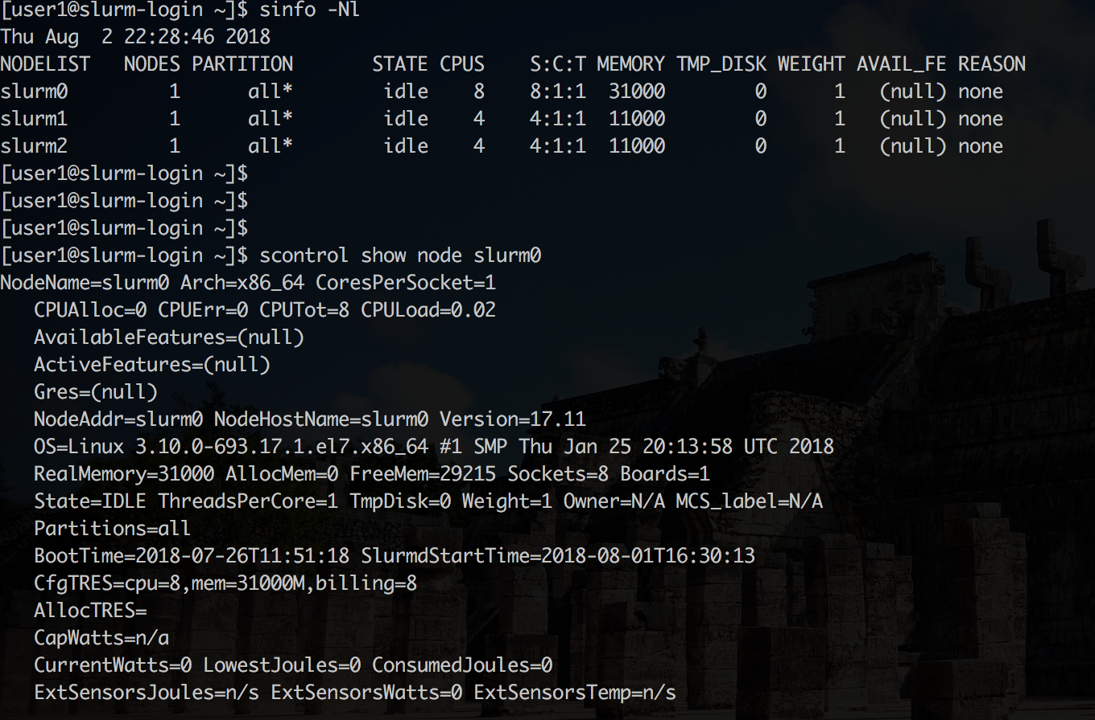

Slide 73
Demonstration
Now use the commands to check the status of a compute node
How many compute node do we have in this cluster?
How many cpu is available for each of the compute node?
How many partition do we have in this cluster?
What is the time limit for each of this partition?
Commands:
sinfo
sinfo -p comp
sinfo -Nl
scontrol show node slurm1

Slide 74
What is a partition?
A partition is a pool of resources, it usually consists of one or more nodes that have the same constraints.
For example:
A partition can have a maximum time limit of 7 days and the default memory per cpu is 4096MB
PartitionName=all Default=yes Nodes=slurm[0-2] State=Up MaxTime=7-0 DefaultTime=02:00:00 DefMemPerCPU=4096 AllowQOS=ALL

Slide 75
Customise your job script?
You can tell the job scheduler how much of the resources do you need to run your job?
Time limit
Memory
Account
Number of tasks
Number of nodes
--ntasks or -n Number of tasks and by default the number of CPUs
--mem Total memory size --time or -t Wall time limit --input or -i File used for standard input (default is /dev/null) --output or -o File used for standard output --error or -e standard error (default is to combine with stdout)

Slide 76
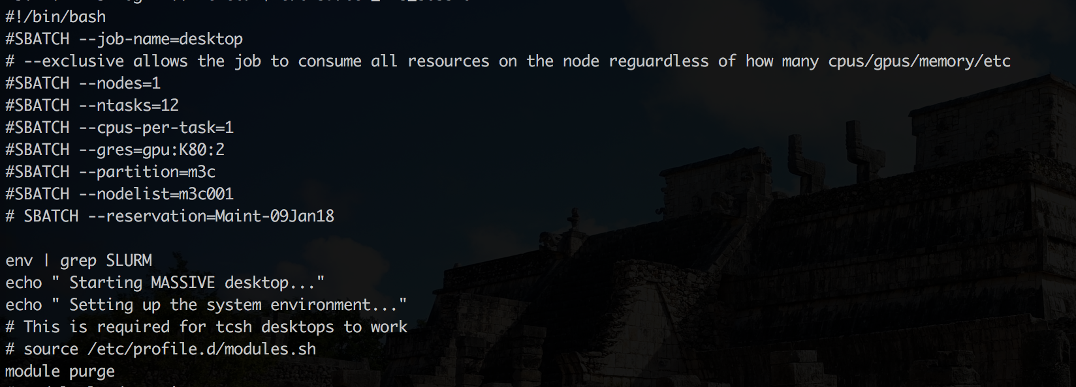
An example of a complex job script:

Slide 77
Exercise: (15 min)
Write a job script to assign 1GB to the job?
Also, add in the time limit as well, set it to 1 mins.
Submit the job and examine the job information.
[Hints] Combine the following with your previous script:
Need help
#!/bin/bash
#SBATCH --mem=1024
#SBATCH --time=00:01:00
All Good

Slide 78
Running a parallel job
srun - Run a parallel job on cluster managed by Slurm. If necessary, srun will
first create a resource allocation in which to run the parallel job.
In this example, we request SLURM to allocate two CPU and precede each standard output or error message with its rank number
The output:
Not sure what an option does?
The Unix Manual system can help
On the shell window, use
man srun
To find out what --label does
srun --ntasks=2 --label hostname
0: slurm1
1: slurm1

Slide 79
Running a parallel job across two nodes:
and the output is:
srun --ntasks=2 -N 2 --label hostname
From srun manual page
-N, --nodes=<minnodes[-maxnodes]>
1: slurm1
0: slurm0

Slide 80
srun vs sbatch
srun runs a command in a parallel environment. It will run one process for every task that you have requested. It can be called from the command line as well as from a sbatch script.
e.g. to get an interactive Bash shell on a compute node from the login node. This is equivalent to ssh’ing into a compute node (with the constraints of running inside a scheduler)
srun --pty bash -i
srun's --pty option runs a task in a pseudo terminal mode.
Bash's -i option tells it to run in interactive mode (with prompts).
sbatch submits a file with SLURM submission information and tasks inside it. Most commonly, srun is called from within a sbatch script. This is necessary for MPI programs.
e.g. inside a file mySubmit.slm you may find a command like
srun myMPIProgram.exe
This will run N versions of myMPIProgram.exe where N is the number of tasks you requested
Putting all your SLURM options and tasks inside a script is the preferred way of doing things, as you have a record of what you have done, and can view it again later.

Slide 81
Exercise: run a job on more than one core/node
To demonstrate the performance differences running a job with one core vs two cores.
$ mkdir mpi $ cd mpi $ cp -r /usr/local/exercises/mpi/* .
- examine run.sh and see what it does - modify slurm.slm to request two CPU - submit job with sbatch
- examine the output
[Hints]
#!/bin/sh
#SBATCH --job-name=mpitest
#SBATCH --time=00:05:00
#SBATCH --ntasks=2
#SBATCH --cpus-per-task=1
#SBATCH --partition=comp
./run.sh
Need help
All Good

Slide 82
CHAPTER 5 : Accessing Software

Slide 83
User Environment
HPC systems can support a large and complex range of software
Operating System (Ubuntu, CentOS)
Compilers (e.g. Intel, GCC, Cray, PGI)
Debuggers and Profilers (e.g. MAP , DDT)
Performance mathematical libraries (e.g. Intel’s MKL, Lapack, Petsc)
Parallel programming libraries (e.g. MPI)
File format libraries for parallel IO (e.g. HDF5)
Project groups may be expected to manage the installation of their own software stack.
All of the above software is not immediately available as soon as you log in.

Slide 84
Environment Modules
To prevent conflicts between software names and versions, applications and libraries are not installed in the standard directory locations.
Modules modify the environment to easily locate software, libraries, documentation, or particular versions of the software
module load openmpi

Slide 85
Module Commands
Command | Description
module avail | Show available modules
module list | List loaded modules
module load modulename | Load a module into the current environment
module rm|unload modulename | Unload a module from the environment
module purge | Unload all loaded modules
module swap module1 module2 | Swap a loaded module with another
module show modulename | Give help for a particular module
module help | Show module specific help

Slide 86
How it works…
Unix shells (Bash. C-shell, etc) use system environment variables to define important values
By convention, these variables use upper-case letters
The shell command printenv prints all the variables
To look at a particular one, we use ‘echo’ and the variable name
i.e. to look at the PATH variable we type
echo $PATH
Note the $ is used to tell shell that we are looking for a variable called PATH
Another important variable is LD_LIBRARY_PATH that lists the locations of shared libraries.
Modules work by modifying these variables in a very easy to use manner, independent of the shell you are using.

Slide 87
PATH is used by the shell to search where executables might be. The shell command which is used to find the path of an executable.
For example, lets look for where our Python executable may be
which python
/usr/bin/python
And we can ask Python which version it is
python --version
Python 2.7.5
Suppose we wanted the latest version of Python ?

Slide 88
module avail
So before we install the latest version, or request the Help Desk to do it, let’s check the modules
module avail python
-----------/usr/local/Modules/modulefiles --------------------------
python/2.7.12
So let’s use it!
module load python
Let’s check we have the right version
which python
/usr/local/python/2.7.12/bin/python
python --version
Python 2.7.12

Slide 89
Removing Modules
Suppose we wanted to go back to using the system python. This can be done with a number of commands
module rm python
module delete python
module purge #remove ALL modules, not just python
Let’s check we have gone back to our original version
which python
/usr/bin/python
python –version
module list

Slide 90
module Versions
It’s possible to have lots of different versions of the same software
module avail python
------/usr/local/Modules/modulefiles
python/2.7.12-gcc python/2.7.8-gcc(default) python/2.7-intel python/3.4.3-gcc python/3.5.1-gcc
Environment module lets you specify the version, or swap between them
module load python #loads the default, same as module load python/2.7.8-gcc
which python
/usr/local/python/2.7.8-gcc/bin/python
module swap python/2.7-intel #unloads the existing Python, then loads the version
#compiled with the intel compiler
which python
/usr/local/python/2.7-intel/bin/python

Slide 91
Exercise 6
Build on previous work, write a script (say interrogate.sh) to interrogates a node for information
Print the hostname (hostname)
Print the time of day (date)
Look for an OS system python
What is its path?
What version is it?
Load Python via modules
What is its path?
What version is it?
Print a farewell message and time
All Good
Need help
Once you have run this on the login node, write a slurm script to run interrogate.sh on a single node
If you have time, modify the slurm script to run on 2 nodes.
Remember to use srun when invoking interrogate.sh
Is the output of the text what you expect?

Slide 92



CHAPTER 6 : Transferring software

Slide 93
scp – Copying files between computers
You can copy files between computers with scp – ‘secure cp’
scp has similar syntax to cp. You specify the username and machine name of the remote host in the command line
scp <from> <to>
where <from> or <to> can also specify a username@computername:
e.g.
scp *.db username@computer:/home/apps/dbfiles
Note the ‘:’
The wild card *.db matches any filename whose ending is the string ‘.db’

Slide 94
scp – Copying files between computers
EXAMPLES (Using a computer called raijin.nci.org.au with a user called vader):
Other interesting options (‘man cp’)
-i <identity_file> use a predefined crypto-key file, removing the need to use a password. Use with caution!
-r copy directories recursively
COPYING TWO FILES TO RAIJIN
scp mfile.c myfile.h vader@raijin.nci.org.au:
COPYING FROM RAIJIN WITH A WILDCARD
scp vader@raijin.nci.org.au:mydata/*.dat /home/user

Slide 95

dos2unix and unix2dos
In Windows (DOS), text files have every line terminated with two characters –CARRIAGE RETURN and LINEFEED =>
Using the C computer language syntax, this maps to \r\n
In Unix and Mac, text files have every line terminated with \n only
When viewing a DOS file in Unix, you may see a ^M at the end of every line.
Or worst, the character may appear invisible and cause errors later !
Two tools exist to convert text files between the two Operating systems
dos2unix <filename>
unix2dos <filename>

Slide 96

Making files easier to move
COMPRESSING FILES
Lossless compression of files is useful:
When transmitting files across the internet
Saving space in your file system (NCI have quotas)
There are many tools to compress files. One of the most common is gzip.
To compress a file:
gzip myfile.txt
Produces a file called myfile.txt.gz (and removes myfile.txt)
To get the file back:
gunzip myfile.txt.gz
Produces a file called myfile.txt (and removes myfile.txt.gz)

Slide 97

Creating and extracting archives
Archiving files
It is often useful to combine a large number of files into one big file
When transmitting files across the internet
Quicker access on tape archive systems
Your file system may have limits on the number of files you can have (NCI have quotas on this – the inode quota)
There are many tools to archive files. One of the most common is tar.
To create an archive:
tar –cf archive.file.name.tar <list of files>
Produces a file called archive.file.name.tar
To extract the archive
tar -xf archive.file.name.tar
Extracts all the files in the archive
Once an archive is created, it is a good idea to compress it as well.
This can be done automatically with tar by adding the –z flag. i.e. tar –cfz …

Slide 98
Exercise
You want to copy some data from another machine to your home directory.
You know the file is called whatami.tar.gz and it lives in /tmp of a machine called slurm0.
Use scp to fetch the file to your home on the login node. Don’t forget the “.” at the end of the line.
All Good
scp slurm0:/tmp/whatami.tar.gz .
Need help
Check that your the scp worked and you have a file called whatami.tar.gz in your directory. Now lets see what is in the archive..
tar -xf whatami.tar.gz
Note:
The /tmp file system of every Unix server is a disk local only to that node. I.e. the /tmp of every machine will be different.
Use ls and cat to see what was produced by the file.

Slide 99
CHAPTER 7 : Using resources effectively

Slide 100
Although we covered requesting resources from the scheduler earlier, how do we know how much and what type of resources we will need in the first place?
Answer: we don’t. Not until we’ve tried it ourselves at least once. We’ll need to benchmark our job and experiment with it before we know how much it needs in the way of resources.
sacct -u {userID}
sacct -j {jobID} -l
Hostname - Where did your job run?
MaxRSS - What was the maximum amount of memory used?
Elapsed - How long did the job take?
State - What is the job currently doing/what happened to it?
MaxDiskRead - Amount of data read from disk.
MaxDiskWrite - Amount of data written to disk.

Slide 101
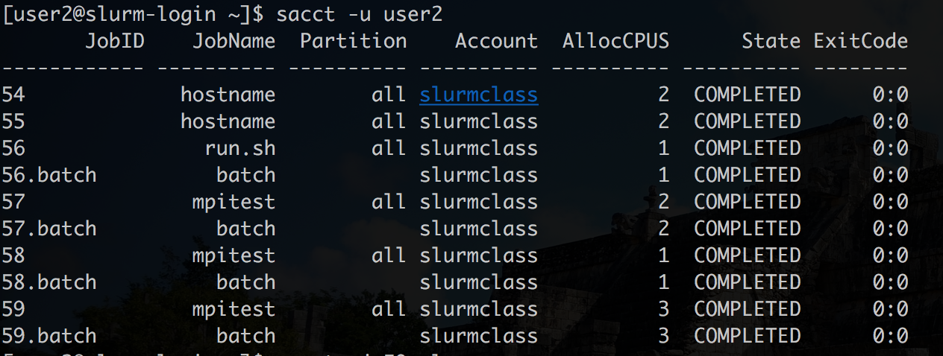

Slide 102
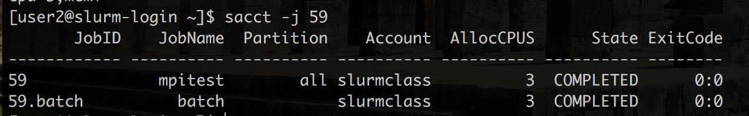
The state showing that the job is completed successfully.
The partition that was used in `all`
The account that was used is `slurmclass`

Slide 103
If you would like to see more information about a job, you can always customise the format for your command
sacct -j 59 --format=User,JobID,Jobname,partition,state,time,start,end,elapsed,MaxRss,ncpus,nodelist

Slide 104
Why is my job not running?
Use “squeue --start” command
Jobs will be listed in order expected start time
Depending upon configuration, not all jobs may have a start time set
Times are only estimates and subject to change

Slide 105
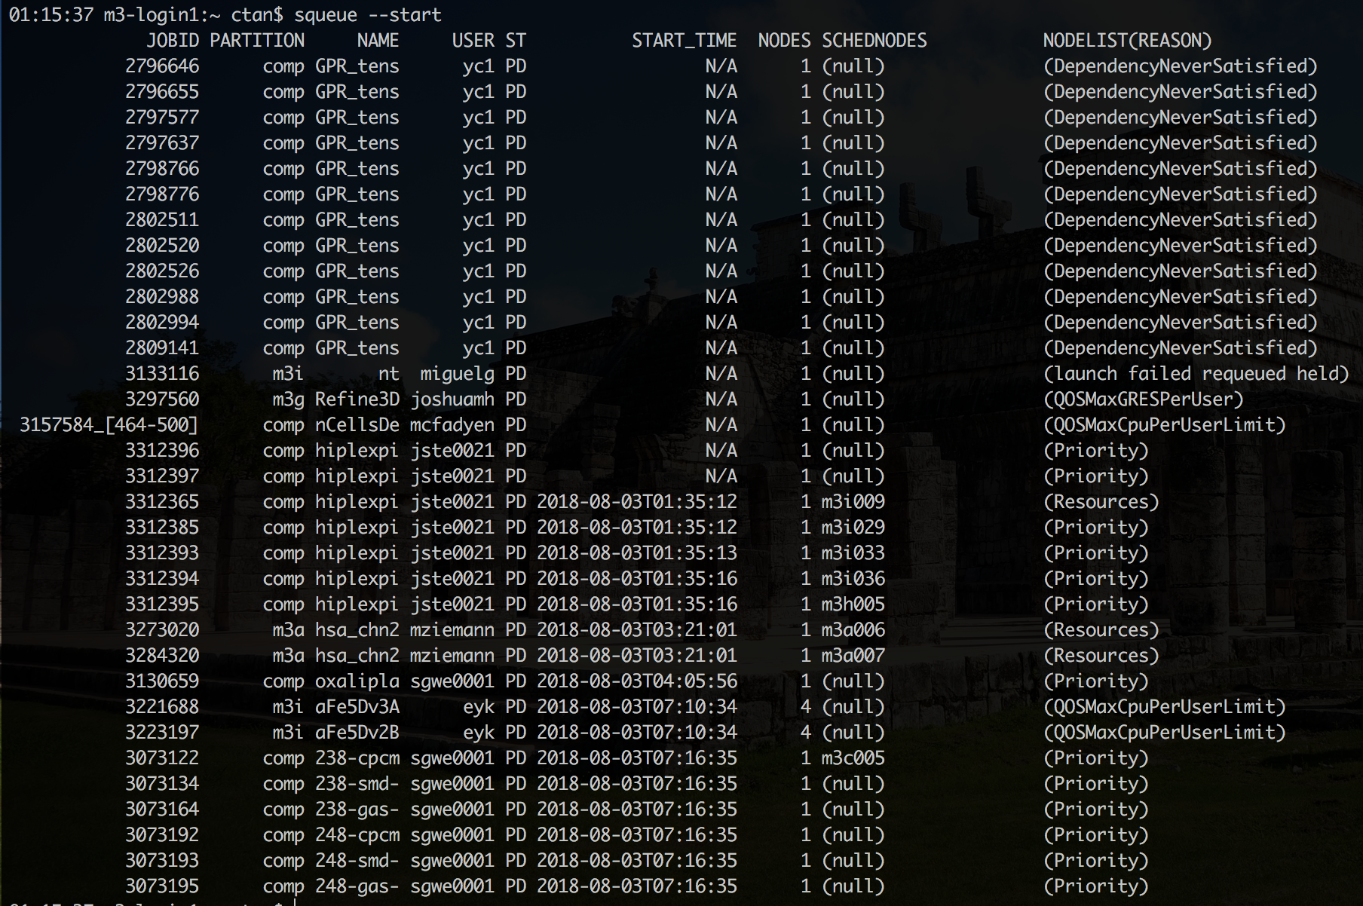

Slide 106
Be kind to the login node
The login node is very busy managing lots and lots of jobs! It doesn’t have any extra space to run computational work. Don’t run jobs on the login node, you can use the interactive session to test out your script.
Remember, the login node is to be shared with other users.
If someone is being inappropriate and using the login node to run all of their stuff, message an administrator to take a look at things and deal with them.
Test before scaling
Before submitting a large run of jobs, submit one as a test first to make sure everything works.
Understanding the filesystem
always know where to write your data, in the production system, there’s usually some space that being backed up and some space might be allocated for scratch
make sure you check your quota for each of this filesystem

Slide 107
Save time
Compress files before transferring to save file transfer times with large datasets.
The less resources you ask for, the faster your jobs will find a slot in which to run. Lots of small jobs generally beat a couple big jobs.
Software tips
You can generally install software yourself, but if you want a shared installation of some kind, it might be a good idea to message an administrator.
Always use the default compilers if possible. Newer compilers are great, but older stuff generally has less compatibility issues.

Slide 108
HPC Clusters in Monash University

Slide 109


MASSIVE M3
A Computer for Next-Generation Data Science
1,700 Intel Haswell CPU-cores
2,000 Intel Skylake CPU-cores
48 NVIDIA Tesla K80 GPU
20 NVIDIA Tesla P100 GPU
60 NVIDIA Tesla V100 GPU
coprocessors for data processing and high end visualisation
A 3 petabyte Lustre parallel file system
100 Gb/s Ethernet Mellanox Spectrum
Supplied by Dell, Mellanox and NVIDIA
STRUDEL (desktop.massive.org.au)

Slide 110

Monarch

Slide 111

WRAPPING UP
Do you have the tools you need to do your Research?
Would you want to know more?
Email mcc-help@monash.edu
Data Fluency Slack Channel
Bioinformatic Drop-in (every Friday)
https://docs.monarch.erc.monash.edu.au
https://docs.massive.org.au
HPC web sites (i.e. www.nci.org.au or https://pawsey.org.au/)
Google

Slide 112
To get credit for this course you MUST fill out a feedback form
https://forms.gle/ALT2SRLpmJjMSJCaA

Slide 113
Your Feedback please!
ONE THING YOU LIKED
ONE THING TO IMPROVE

